Slide 1
Dissertation Survey Research Results
From Enfield Highway Over 50s Club
Completed by 14 Carers & Family of People with Alzheimer’s.
General Opinions on Current & Future Technology
Technology Used To Assist with Alzheimer’s
Which of the following methods do you think are helpful for Alzheimer’s?
50%
Positive
Helpful / Exciting / Enjoyable / Useful
14% Negative
Confusing / Frightening / Uninterested
From the 10 technologies / products listed, people had used:
Number of Products | People
None | 4
1 | 3
2 | 1
3 | 2
4 | 3
5 | 1
""My father does not and could / would not use a mobile phone, I can and do show him pictures and play music that he recognises which gives him some pleasure"
36%
No Opinion
"I am unaware or have no knowledge of current/future technology hence cannot give an opinion"
Most Popular
Mobile / Tablet Apps
Healthcare Websites
Dated Pill boxes / Dispensers
Least Popular
Voice Assistants
Smart Home Tech
Telecare Systems
"Anything that brings back childhood, using hands, they like to fiddle with things. They remember their homes and places from far back, something that families can fill in of photos over the years of homes”

Slide 2
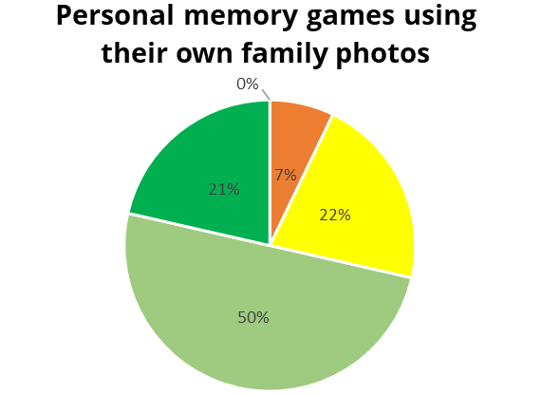
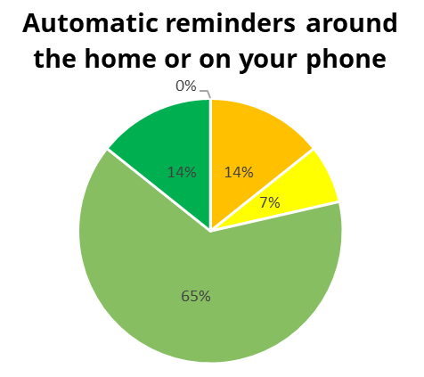
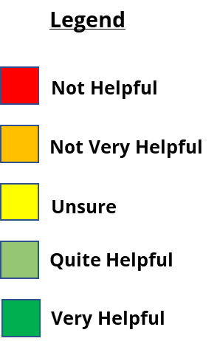
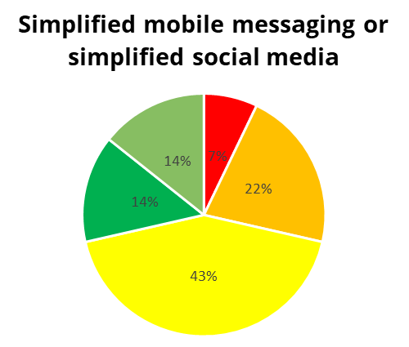
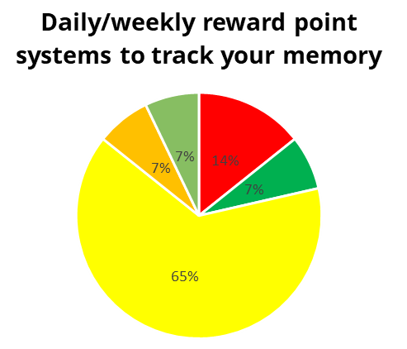
How helpful do you think the following ideas could be?

